Slide 1
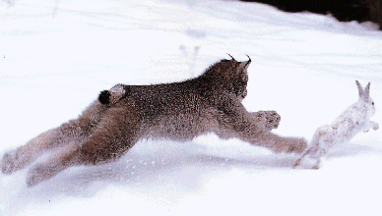
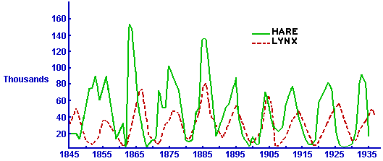
Example System: Predator Prey Model
https://www.math.duke.edu/education/webfeatsII/Word2HTML/Predator-prey.doc

Slide 2
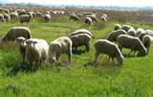

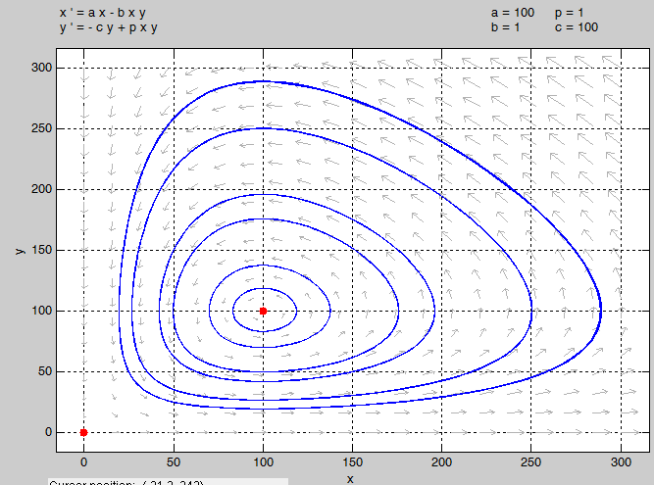
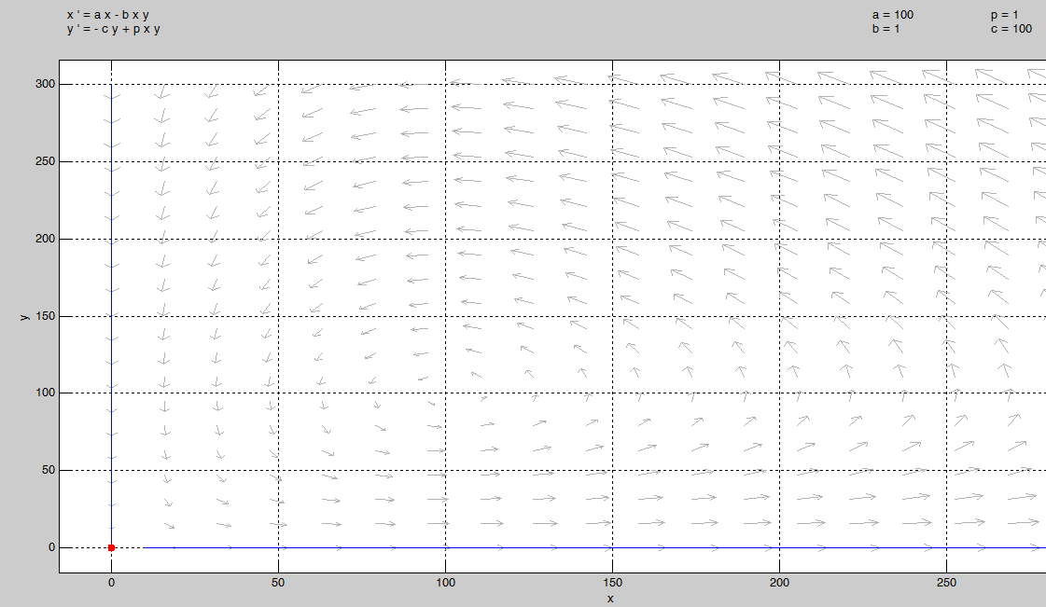
Example System: Predator Prey Model
Without prey the predators become extinct
Without predators the prey grows unbounded
Populations Oscillate

Slide 3
Chapter 3
Lyapunov Stability – Autonomous Systems
System of differential equations
Question: Is this system “well behaved”?
Follow Up Question: What does well behaved mean?
Do the states go to fixed values?
Do the states stay bounded ?
Do we know limits on the size of the states?
If we could “solve” the system then theses questions may be easy to answer.
We are assuming we can’t solve our systems of interest.
Bottom line in this chapter is that we want to know if a differential equation, which we can’t solve, is “well behaved”?

Slide 4
Preview
x₂
x₂
System stops moving, “stable”
x₁
x₁
x(0)
x(0)
How can we know which way our system behaves?
System state grows, “unstable”

Slide 5
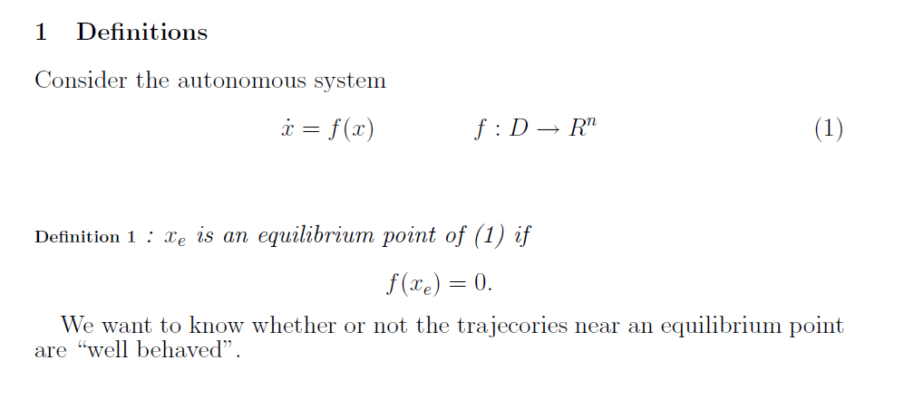
No explicit time dependence.
The solution will evolve with time, i.e. x(t)
Open or closed-loop system
Three main issues:
System is nonlinear
f is a vector
Can’t find a solution
Can have multiple equilibrium points
We will work to quantify “well behaved”

Slide 6
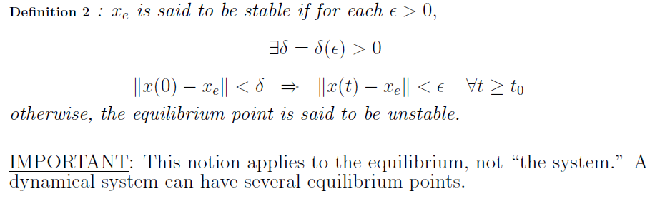
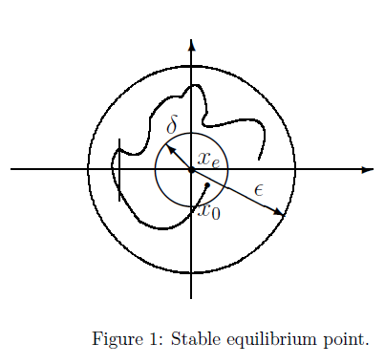
Starting time (typically 0)
Evolution of the state
x₂
Khalil calls this the “Challenge and answer form to demonstrate stability”
Challenger proposes an ε bound for the final state
The answerer has to produce a δ bound on the initial condition so that the state always stays in the ε bound.
Answerer has to provide an answer for every ε proposed
x₁
Bottom line: If we start close enough to x_{e} we stay close to x_{e}

Slide 7
Pendulum without friction.
Is (0,0) a stable equilibrium point in the sense of Definition 2?
Yes

Slide 8
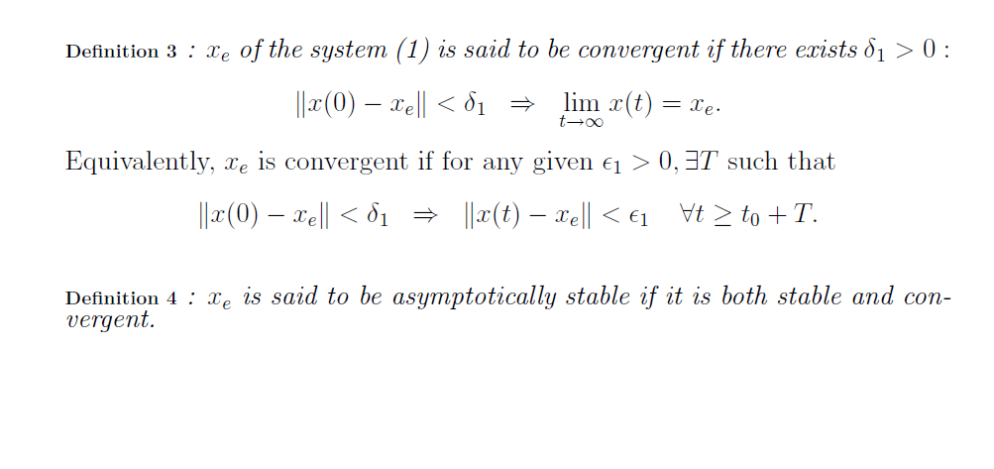
x(t) goes to x_{e} as t goes to ∞
A equilibrium point could be Stable and not Convergent
An equilibrium point could be Convergent and Not Stable

Slide 9
Pendulum without friction.
Is (0,0) convergent?
Is (0,0) asymptotically stable?
No
No

Slide 10
Pendulum with friction.
Is (0,0) a stable equilibrium point in the sense of Definition 2?
Is (0,0) convergent?
Is (0,0) asymptotically stable?
Yes
Yes
Yes

Slide 11
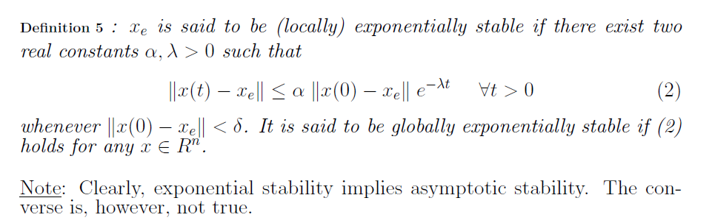
Includes a sense of “how fast” the system converges.
Exponential is “stricter” than asymptotic

Slide 12
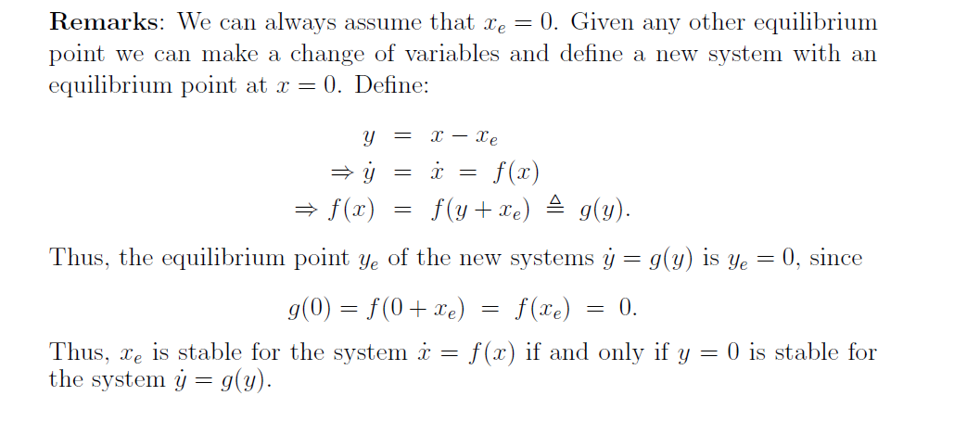
Can perform this shift to any equilibrium point of interest (a system may have multiple equilibrium points)

Slide 13
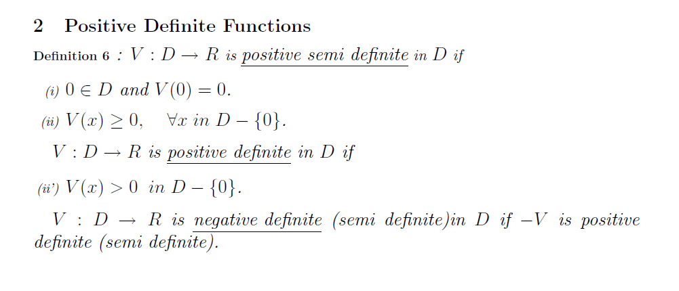
V is a scalar function
Notation:
PSD write as V≥0
PD write as V>0
NSD write as V≤0
ND write as V<0
Could be V(x₁(t))
Example: Are each of these PSD, PD, ND, or NSD?
V(x₁)
V(x₁)
V(x₁)
V(x₁)
None
ND
x₁
x₁
x₁
x₁
PSD
PD
Could be x₁(t)

Slide 14
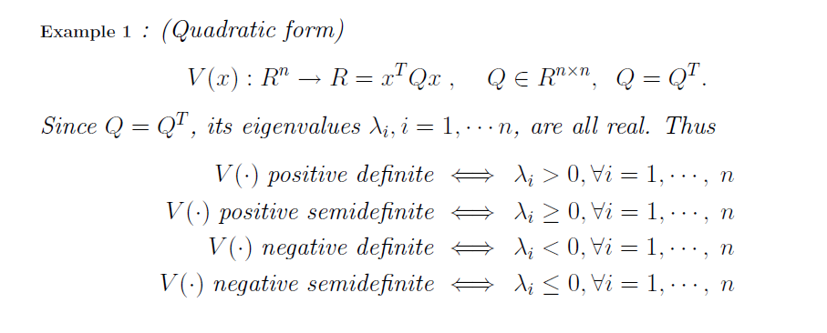
V(x₁)
Example:
x₁

Slide 15
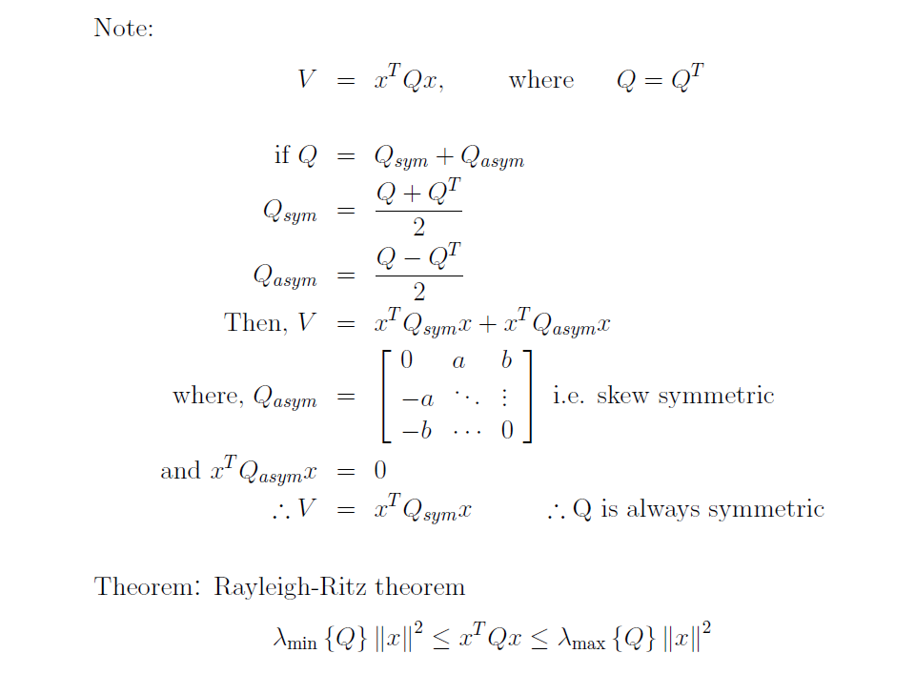
Don’t loose generality by restricting Q to be symmetric in quadratic form
i.e., Q symmetric
See chapter 2
i.e. only the symmetric part contributes to the quadratic

Slide 17
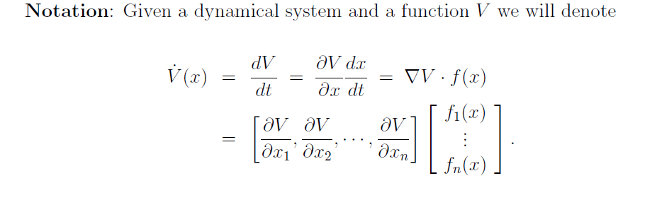
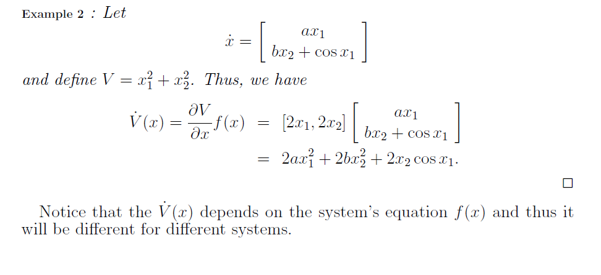
V is a general function of x₁ and x₂

Slide 18
Where is this going?
x₁² could be an abstraction of the energy stored in the system
Analogy would work for potential energy of a spring or charge on a capacitor
V(x)
x₁
Let’s say that x₁ is the state of our system
V(x₁(t))
How could that happen?
V(x₁(t)) will not increase
Could be negative
Gradient
System equations
t

Slide 19
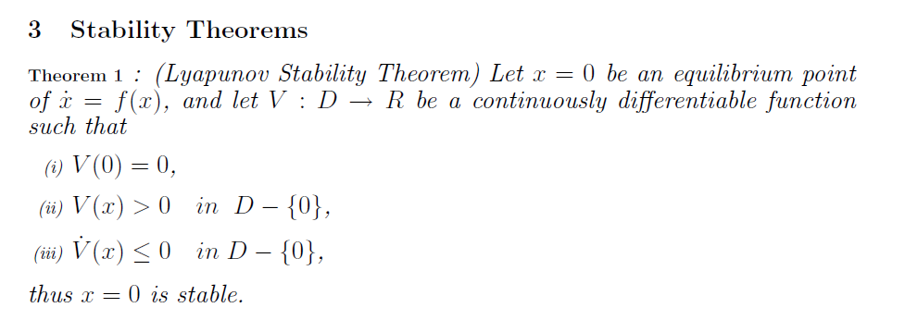
Can take as many derivatives as you need
Eventually we will perform the control design to make this true
Recall that we are considering the equilibrium point at the origin; thus, we already know
0

Slide 20
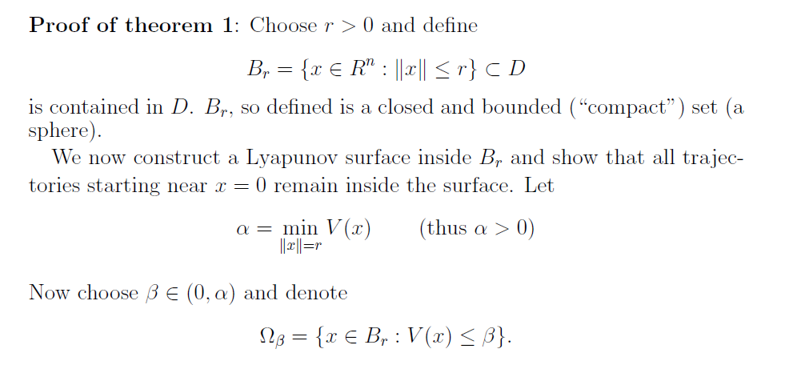


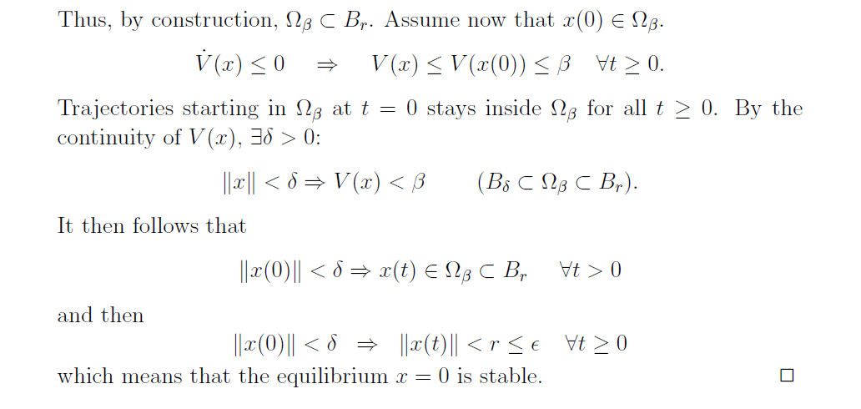
B_{r} is a ball about the origin. Our Theorem only applies at the origin
Every convergent sequence has a convergent subsequence in B_{r}

Slide 21
Proof of Theorem 1 (cont):
Closeness of x to x=0 implies closeness of V(x) to V(0)
By the
Definition of stability

Slide 22
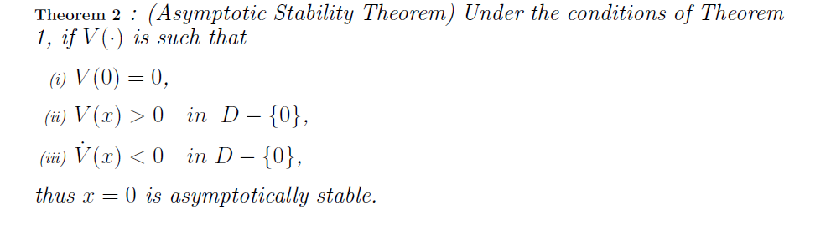

Slide 23
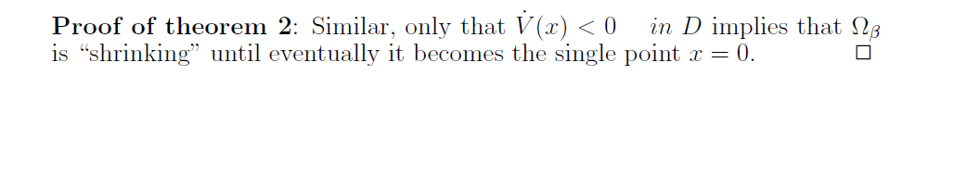
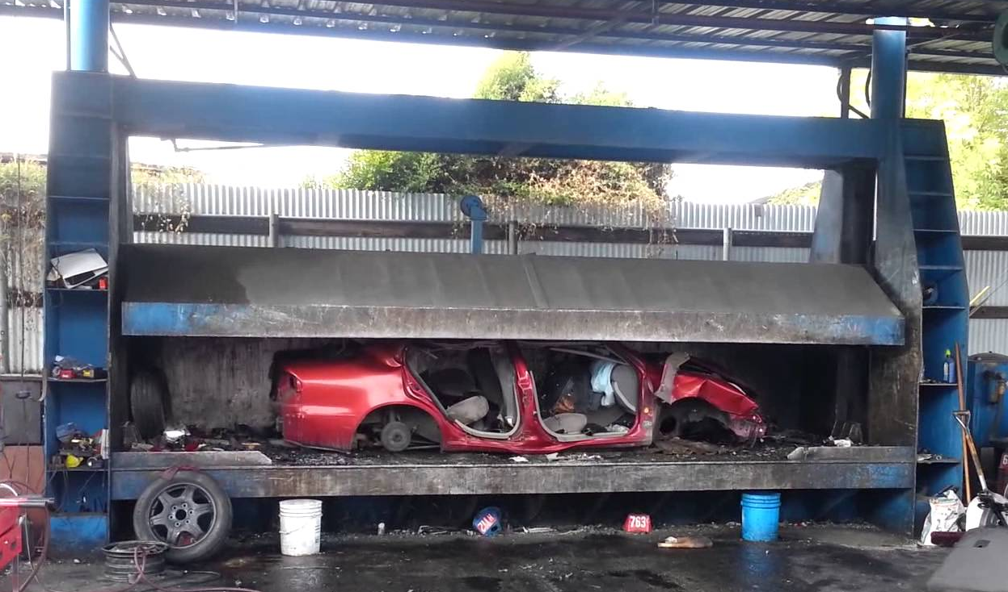

Slide 24
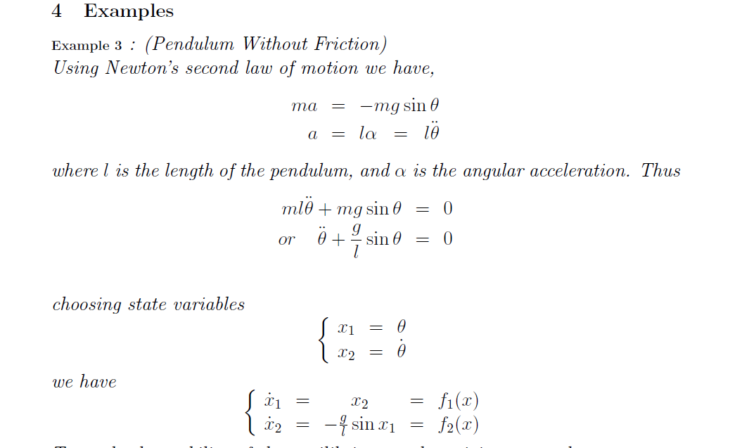
θ
l
mg
Not required to be able to derive these equations for this class.

Slide 25
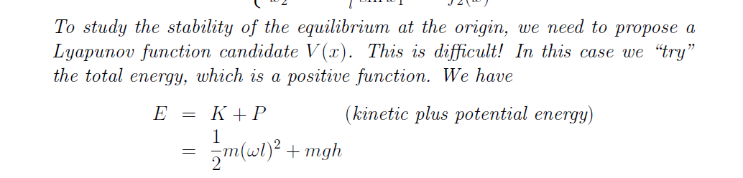
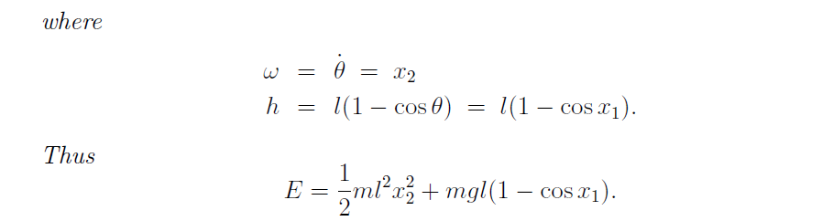
Example 3 (cont)
l-h
θ
l
v
h
mg

Slide 26
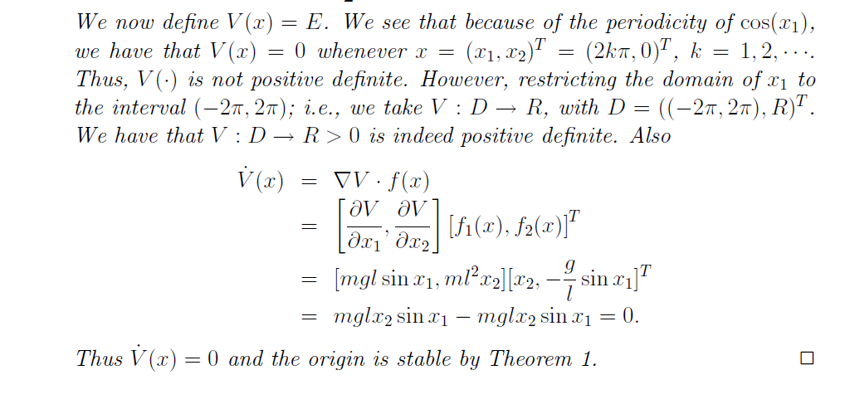
Example 3 (cont)
Note: open interval that does not include 2π, −2π
Note:
Stable implies that the system (pendulum position and velocity) remains bounded
Does not mean that the system has stopped moving
The energy is constant (V=E) but the system continuously moves exchanging kinetic and potential energy Limit Cycle)

Slide 27
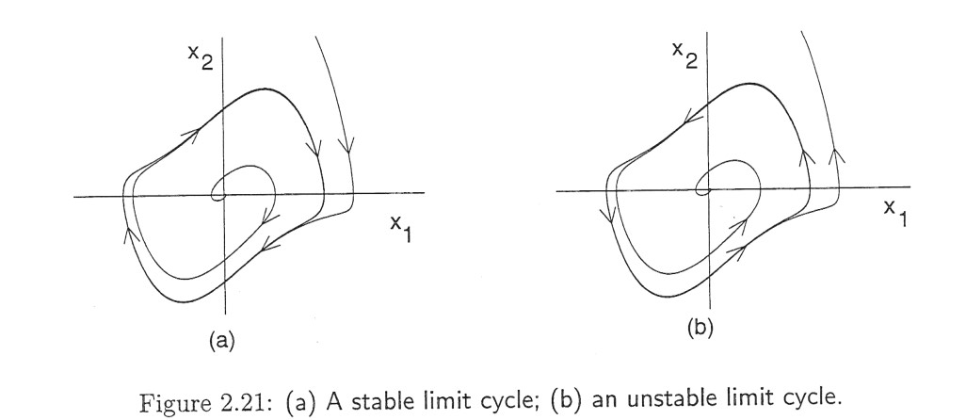
Limit Cycles
Oscillation leads to a closed path in the phase plane, called periodic orbits. For example, the pendulum has a continuum of closed paths
If there is a single, isolated periodic orbit such that all trajectories tend to that periodic orbit then it is called a stable limit cycle.
Can also have unstable limit cycles.
Khalil, Nonlinear Systems 3rd Ed, p59

Slide 28
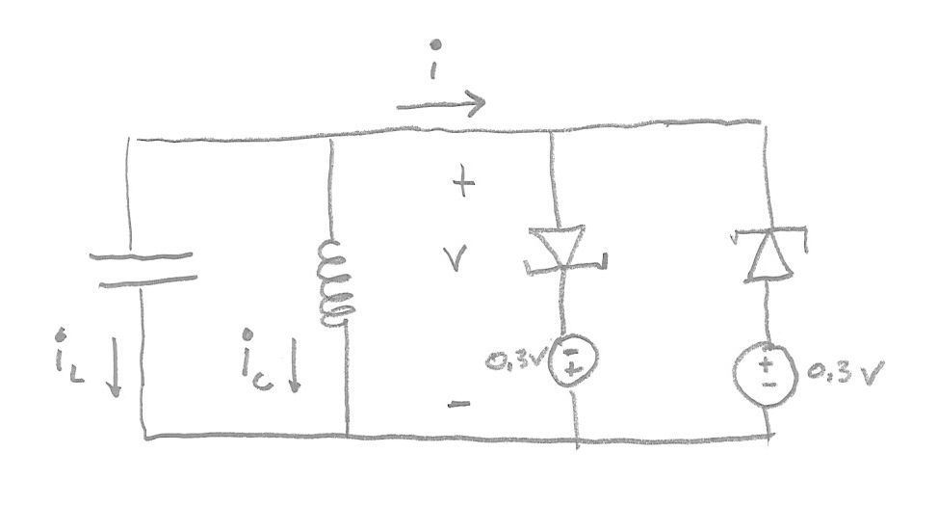
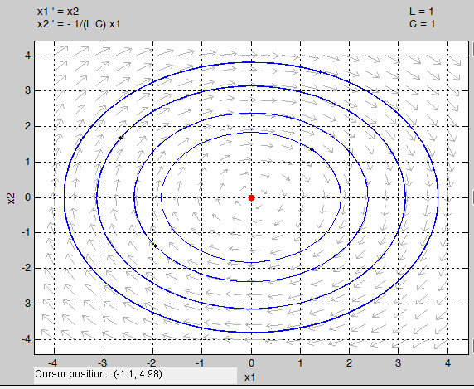
Example: LC Oscillator
1
Khalil, Nonlinear Systems 3rd Ed, p59

Slide 29
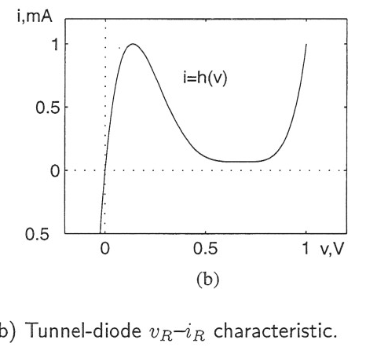
Example: Oscillator
i_{R1}
i_{R2}
v_{sys}
v_{D}
i=h(v)
v
Khalil, Nonlinear Systems 3rd Ed, p59

Slide 30

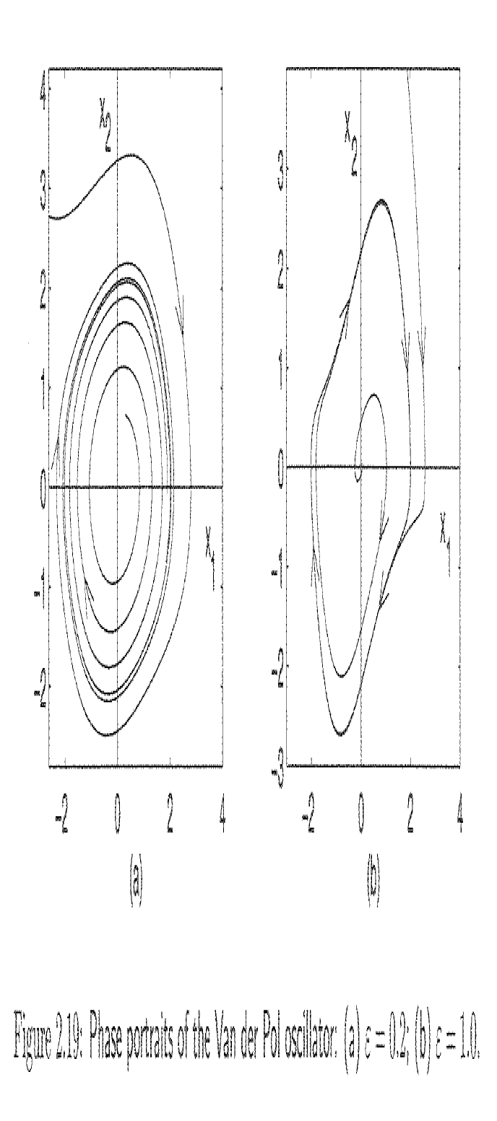
Example: Oscillator

Slide 31
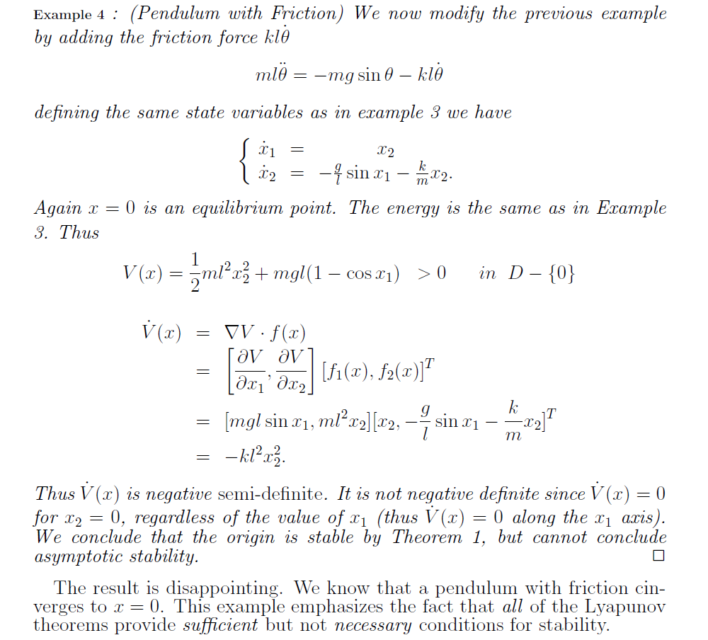
friction
We would expect that the friction will take energy out of the system, thus the system will stop moving.
ND?
NSD?

Slide 32
Example 4 (cont)
Physically, we know that the system will stop because of the friction but our analysis does not show this (we only show it is Stable but can’t show Asymptotic Stability).
We know the system is asymptotically stable even if that is not illustrated by this specific Lyapunov analysis.
Note: We will return to this later and fix using the Invariant Set Theorem.

Slide 33
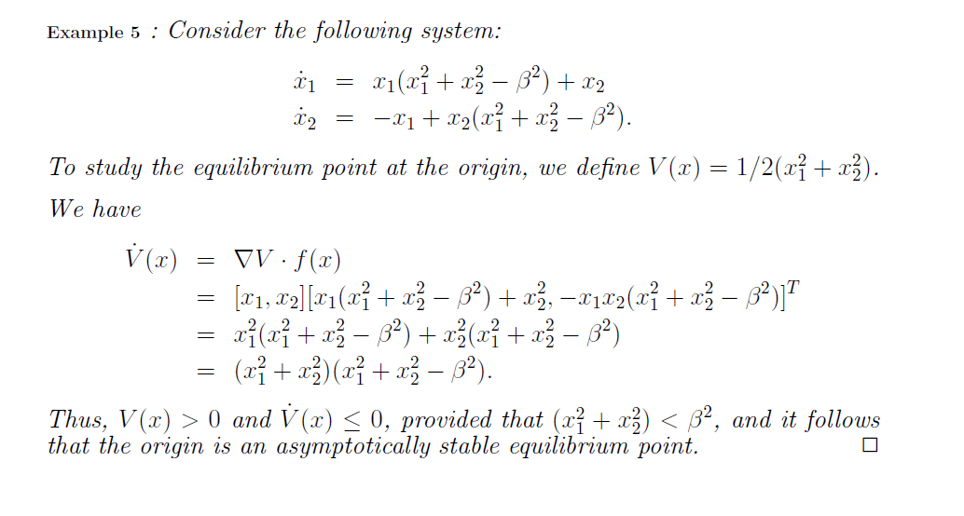

+
This is a Local stability result because we have limited the range of the state variables for which the result applies.

Slide 34
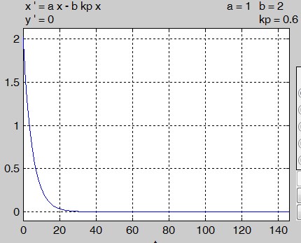
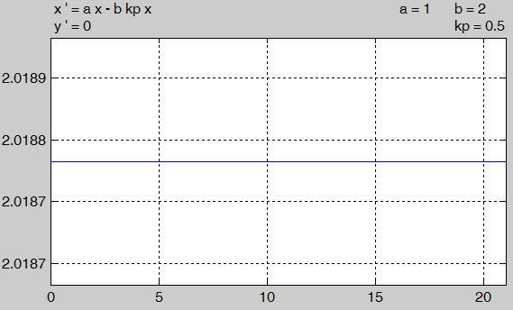
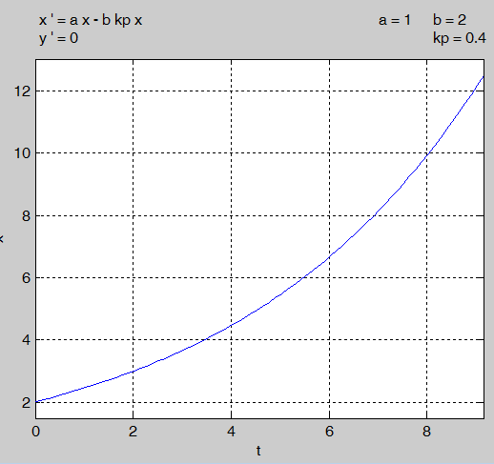
Have we learned anything useful?
x
Given control design problem:
t(sec)

Slide 35
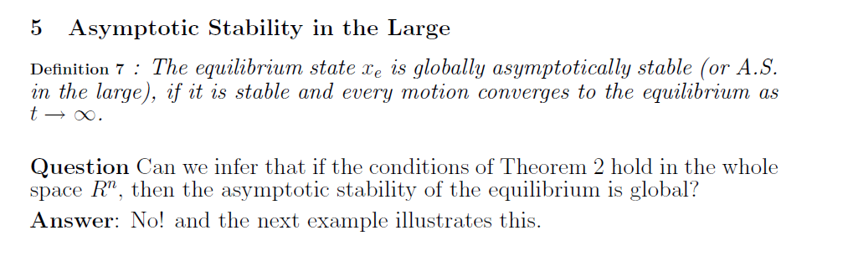
There is a missing piece in our original proof that prevents us from applying the result globally:

Slide 36
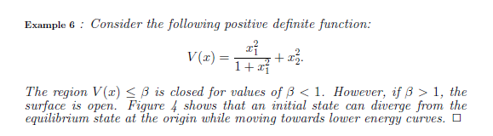
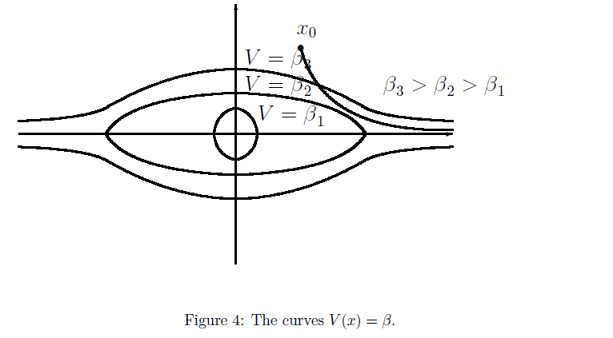
Evolution of the state (green line)
State x₁ gets large but it is trapped by the constant Lyapunov function
Constant V(x₁,x₂) contours

Slide 37
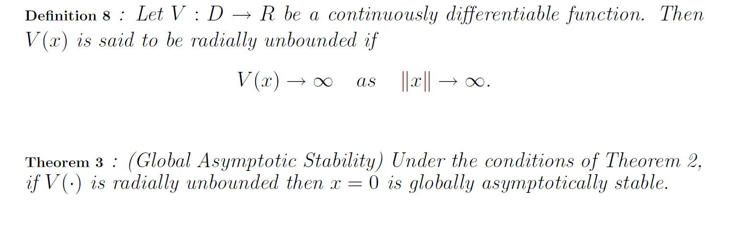
Add this condition to AS Theorem:
:
Fixes the problem that the Theorem 2 was local.
Global AS: The states will go to zero as time increases from any finite starting state

Slide 38
To be radially unbounded the condition must be verified along any path that results in:

Slide 39
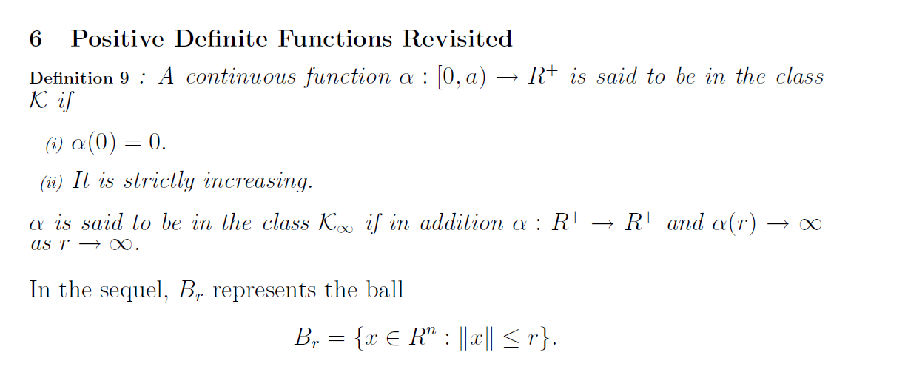
scalar function
like radially unbounded

Slide 40
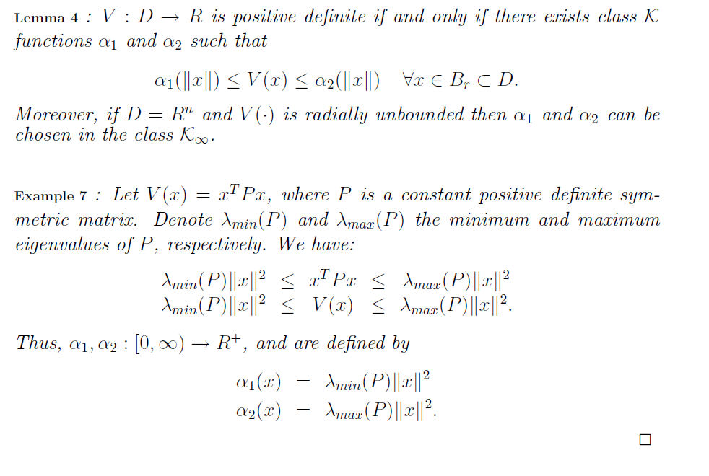
V is PD iif there are class K functions that upper and lower bound the Lyapunov function.

Slide 41
Raleigh-Ritz Theorem.

Slide 42
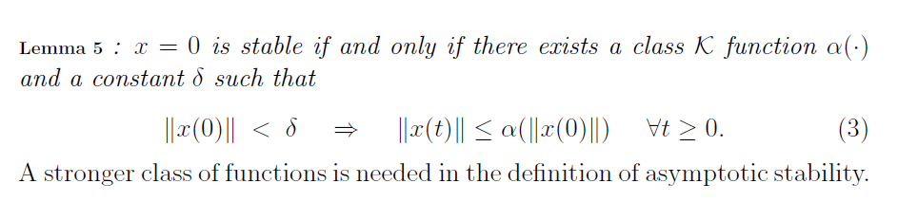
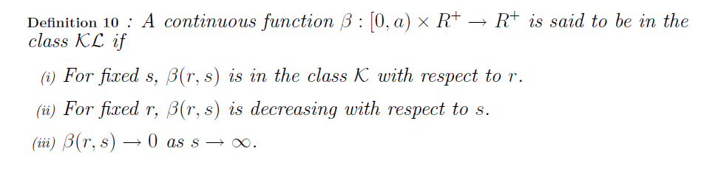
Summary: If the state starts within some ball, then the state remains within some other ball for all times.
We will eventually use t here

Slide 43
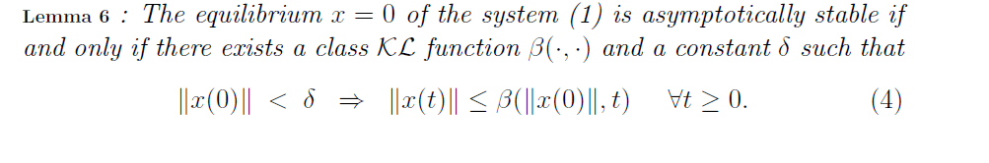

Slide 44
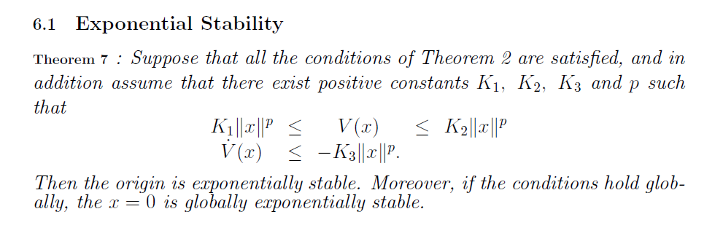
Reminder of Theorem 2 (need on next slide)

Slide 45
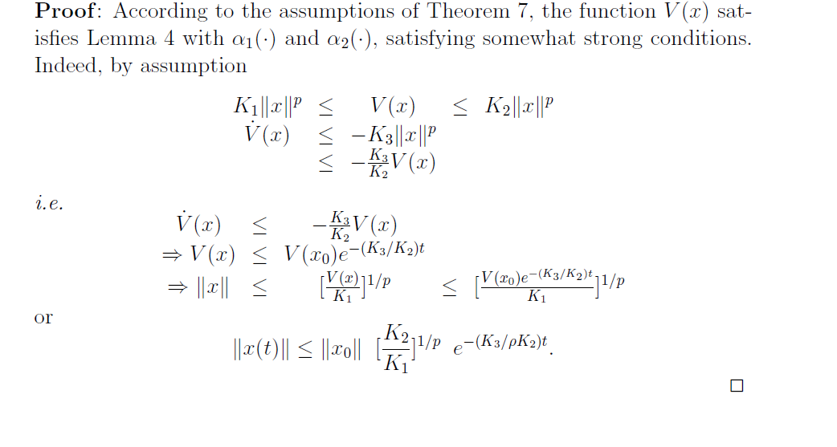
Solve rhs and substitute a new upper bound
Solve lhs
Solve the differential inequality
Find p^{th} root
p

Slide 46
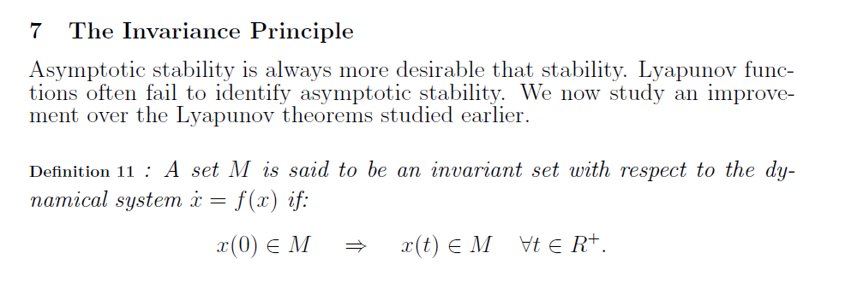
Now want to address the problem demonstrated in the pendulum with friction example, couldn’t show function was negative definite using energy arguments.
“What happens in M stays in M”
Now want to address the problem demonstrated in the pendulum with friction example, couldn’t show function was negative definite using energy arguments.

Slide 47
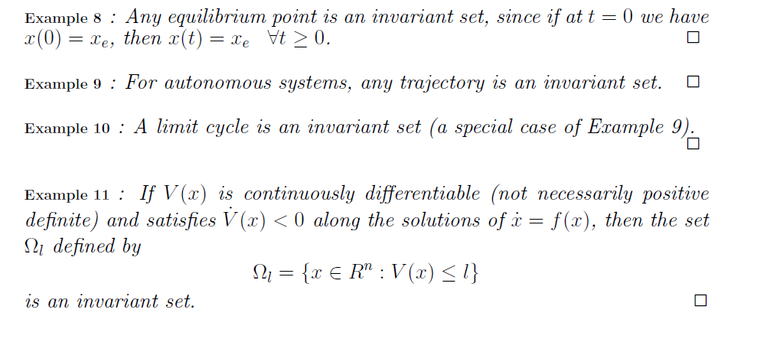
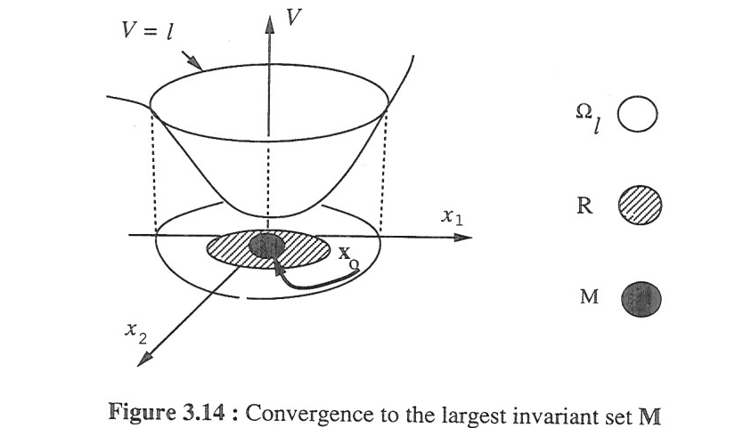
An oscillator has a limit cycle
Slotine and Li, Applied Nonlinear Control

Slide 48


Slide 49


Slide 51

iv)
"vanish identically" -> exactly =0
(vs. approaching zero)

Slide 52

i) PD
iv) Radially Unbounded
ii) NSD
Stays at x₂=0 forever, i.e. doesn’t move
iii) Doesn’t vanish along a trajectory except x₁=0

Slide 53

Different from Lyapunov Theorem because:
V does not need to be Positive Definite
Applies to multiple equilibrium points and limit cycles

Slide 54


Example of LaSalle’s Theorem
System:
Equilibrium Points:

Slide 55
Example of LaSalle’s Theorem (cont)
Lyapunov Function Candidate:
Can we change the Lyapunov function to yield a better derivative?
: It would be nice if this was a “1”
Lyapunov function design is an iterative process!

Slide 56
Example of LaSalle’s Theorem (cont)
Lyapunov Function Candidate:
Can we further change the Lyapunov function to yield a better derivative?

Slide 57

Example of LaSalle’s Theorem (cont)
Is V PD? no
We have enough information to conclude the system is “stable” in some region
-> set is invariant wrt the system

Slide 58

Example of LaSalle’s Theorem (cont)
Lyapunov Function Candidate:
M
N

Slide 59
Example of LaSalle’s Theorem (cont)

Slide 60

Not negative beyond this point

Slide 61



Slide 62

D
However, it does look like there should be a region such that the system converges.
Can we define that region?

Slide 63
Define Region of Attraction (RA):
Question we want to answer: Where can the system start (Initial Conditions at t=0) so that we know it will move to the equilibrium point?

Slide 64

We are assuming we know there is a bound on x²
k
Original assumption , V is decreasing
Solve differential inequality
0
We have now shown there is a bound on x²

Slide 65
Find R_{A} for k=2:
This is our R_{A}:
k=2
Phase portrait:
1
0
x

Slide 66

Estimate Region of Attraction (RA) Using LaSalle’s Theorem:
Doesn’t mean it is the entire RA

Slide 67


Finish Example 14
Could be larger,

Slide 68
Finish Example 14
V(x)
x₂
x₁
Contour lines of V(x)

Slide 69


Slide 70


Slide 71

Proven the “If” part of the Theorem. If Q>0 and found P
then AS real part of eigenvalues is >0
Now prove the “only If” part of the Theorem.

Slide 72


Slide 73


Slide 74
Example: Is the following system AS?
In MATLAB: >> P=lyap([0 -1;1 -1],[1 0;0 1])
Wouldn’t it be easier just to find the eigenvalues of A? Yes, but having P (and hence a Lyapunov function) will be useful later.

Slide 75





Linearization of a Nonlinear System
= 0 by assumption of equilibrium point
Assume small
Change of variables to make the origin the equilibrium

Slide 76



Slide 77


Example: Linearize System
Reminder of Jacobian:
2x2
Eigenvalues = 1,1
Origin is unstable
Notes:
Example from Slotine page 54

Slide 78
Example : Linearize System (cont)
Original System
Linearized
Compare favorably close to the equilibrium point
May compare less favorably further away from equilibrium point

Slide 79


Slide 80
Example System: Predator Prey Model
Without prey the predators become extinct
Without predators the prey grows unbounded
Populations Oscillate

Slide 81




Example System: Predator Prey Model
Linearization at the equilibrium points
Lost idea of oscillating populations
(100,100)
Lost idea of extinction
(0,0)

Slide 82

In general, proving a system is unstable is not very “constructive” in designing control systems.
Unstable equilibrium

Slide 83


Slide 84

Example
Not conclusive, doesn’t mean it is stable

Slide 85

Summary
x=0 stable
convergent
x=0 asymptotically stable
x=0 exponentially stable
x=0 stable
convergent
x=0 asymptotically stable
x=0 exponentially stable
X(t)
X(t)
X(t)
X(t)
time
time
time
time

Slide 86
Summary
10
Local, global
N is asymptotically stable
2
3
1
x=0 stable
x=0 asymptotically stable
Locally, NSD dV/dt
x=0 asymptotically stable
Locally, state could grow
while V shrinks
globally
V is class K
8
7
x=0 exponentially stable
x=0 asymptotically stable
local
global, local depend on conditions
9
Conditions true in entire state space
Global, asymptotically stable

Slide 87
Summary
Linearization
11
x=0 exponentially stable
Inherently local result since it is an approximation of a nonlinear system at a point
system
Linear approximation

Slide 88
Summary
u
f(x)
f₂(x)
u
f(x)
g(x)

Slide 89
Homework
Set 3.A: Pendulum without friction
Set 3.B: Equilibrium points, quadratic Lyapunov function candidate to determine stability
Set 3.C: Book problems 3.1, 3.3, 3.6, 3.7
Set 3.D: Book problems 3.4,3.5,3.13, 3.14
Set 3.E Pendulum with friction AS

Slide 90
Homework #3-A
“Pend w/out friction” - Find all of the equilibrium points for the pendulum without friction.
  Plot the phase portrait from -3π<x₁<3π and -10<x₂<10.
  From inspection of the phase portrait , does it appear that the equilibrium points are stable?
  Use the Lyapunov function candidate from the notes to examine stability at x₁=π and 2π

Slide 91

Homework 3-A
Pend w/out fric
Pendulum spins
Pendulum swings
Pendulum doesn’t move
(stable EQ point)
Pendulum doesn’t move at exactly that point
(Unstable EQ point)

Slide 92
Homework 3-A
Pend w/out fric (cont)
Change of variable
Shifted system
Same Lyapunov function candidate that we used in notes
No
Is the EQ point stable or unstable?
No conclusion can be made

Slide 93
Homework 3-A
Pend w/out fric (cont)
Change of variable
Shifted system
Same Lyapunov function candidate that we used in notes
Yes
Is the EQ point stable or unstable?
Stable

Slide 94
Homework #3-B
Find the equilibrium points for each of the following and use a quadratic Lyapunov function candidate to determine stability of each equilibrium point.
Using a quadratic Lyapunov function, find u=f(x) such that the system is stable at x=0
Using a quadratic Lyapunov function, find the conditions on a,b,c,d such that the system is stable at x=0

Slide 95
Homework 3-B

Slide 96
Homework 3-B

Slide 97
Homework 3-B

Slide 98
Homework 3-B

Slide 99
Homework 3-B

Slide 100
Homework 3-B
We just designed a feedback control to stabilize the system
We used the Lyapunov function to design the control.

Slide 101
Homework 3-B

Slide 102
Homework #3.C
Chapter 3 - Problems 3.1, 3.3, 3.6, 3.7

Slide 103

Homework 3.C
System doesn’t move, i.e. derivatives are zero
Notation means the second eq point, not the square of the eq point
See that (0,0) which corresponds to (1,0) in the original system is an equilibrium point

Slide 104
Homework 3.C
(-1,0)
See that (0,0) which corresponds to (-1,0) in the original system is an equilibrium point

Slide 105


Homework 3.C
Solve for conditions on v (note that this is the voltage on the coil not a Lyapunov function candidate) so that x₁=y_{o} and the system is at rest, i.e. solve v so that there is an equilibrium point at x₁=y_{o.} Approach: set derivatives to zero, x₁ to the constant y_{o} solve for v.

Slide 106

Homework 3.C
Emphasizing that we are looking for a constant x₃
x₁=y_{o}

Slide 107


Homework 3.3 (sol)
This is why linearization can be so powerful tool - you get to use all of the linear analysis tools.

Slide 108

Homework 3.C
Verify that the origin is an equilibrium
Substitute (0,0)

Slide 109
Homework 3.C

Slide 110




Homework 3.C
From pplane8:

Slide 111



Homework 3.C
Test this first
V can be zero other than at the origin

Slide 112
Homework 3.C

Slide 113
Homework 3.D
Chapter 3 - Problems 3.4,3.5,3.13, 3.14

Slide 114

Homework 3.D (Sol)

Slide 115

Homework 3.D (Sol)
For small x₂
Because we assumed small x₂

Slide 116


Homework 3.D (Sol)

Slide 117


Homework 3.D (Sol)

Slide 118
Homework 3.D (Sol)

Slide 119
Homework 3.D (Sol)
This is a clever way to add a degree of freedom to a quadratic Lyapunov function. a,b don’t change the basic nature of the quadratic function, ie still PD and radially unbounded.
a,b provide the opportunity to cancel these cross terms which might have otherwise stopped our analysis (ie had we chosen a=b=1)

Slide 120

Homework 3.D (Sol)
Why choose this? Because someone tried a lot of other V’s that did not work.

Slide 121
Homework 4.E
Pendulum with friction AS

Slide 123
Additional Examples

Slide 124
Additional Examples

